Slide 1
Grade R Maths project External Evaluation Findings & Recommendations
11 July 2018

Slide 2
Presentation overview
Background and methodology
Findings
Project level
District/FP Subject Advisor
Grade R teacher/practitioner level
Learner level
Answering the evaluation questions
Recommendations from the evaluation team

Slide 3
Project description
R-Maths Project led by the WCED in collaboration with the SDU
Aim of improving the quality of Grade R Mathematics teaching
R-Maths Programme materials developed by the SDU in collaboration with the WCED
Implementation via a two-phase, modified cascade model
Training by SDU of FP Subject Advisors (30 hrs)
Training by FP Subject Advisors of Grade R teacher/practitioners (7 x CT = 14 hrs, block training = 30 hrs)
Reflection workshop
PLC on R-Maths
Support provided by SDU (target = up to 28 days per district)
Notes:
The materials which were developed are collectively known as the R-Maths Programme:
A Facilitator’s Guide and Teacher’s Manual for each of the CTs and the block training;
One Concept Guide (three sections: Principles, WCED alignment, Mathematics Content Area);
Four Term Guides (one for each of Terms 1 to 4);
One ‘Big Poster Book’ (with 11 double-spread posters); and
One classroom kit (with Mathematical equipment for eight learners at a time).
Support provided by SDU took many forms but included “dry-runs” prior to each CT and the block training.
The target was provision of up to 28 days per district to be utilised as districts saw fit.

Slide 4
Process theory
Impact theory
Process theory Impact theory
Outcomes
Development of resources
Resource use for training & in the classroom
Short-term
Enhanced knowledge & skills to support Grade R teacher/ practitioners (district officials)
Capacitation of district officials
Medium-term
Training of Grade R teacher/ practitioners
Support to Grade R teacher/ practitioners
Enhanced knowledge & skills to teach Grade R maths (Grade R teacher/practitioners)
Effective teaching
Long-term (impact)
Improved learner performance in mathematics (readiness for Grade 1)
Notes:
If/then statements
It is important to investigate outcomes and impact at each level, as the intervention is being “cascaded” down to the ultimate beneficiaries i.e. learners. If we do not investigate each of the levels we will not know what happens and why the intervention works or does not work.

Slide 5
Evaluation questions
Product and process evaluation questions
1. What does the R-Maths Project entail?
2. What is the context (e.g. rural/urban, socio-economic status of the school community, number of teachers and learners, background of Grade R teacher/practitioners, etc.) within which the implementation is taking place?
3. Is the project being implemented as planned: inputs, outputs and targets?
4. What is the nature and quality of the training, support and resources provided to FP Subject Advisors and teacher/practitioners?
5. What is the level of adoption by FP Subject Advisors and teacher/practitioners?
6. What are the challenges/barriers to implementation by districts and schools?
7. What are the successes and challenges of the partnership model through which this project is being implemented?
8. What are the key mechanisms of change in the case study contexts?
Outcome and impact evaluation questions
9. What is the impact of the project on FP Subject Advisors, Grade R teacher/practitioners and Grade R teacher/practitioners’ teaching practice?
10. Does the R-Maths Project have an impact on Grade R learners’ Mathematical knowledge and skills?
11. What are the successes of and barriers to scalability and embeddedness into the WCED?
12. Has the project met its intended outcomes outlined in the theory of change and logic model?
Notes:
8 process evaluation questions
4 outcome/impact evaluation questions

Slide 6
Data collection methods and sources
Activities | Level
 | Project/ province | District/ Subject Advisor | HoD | Teacher | Learner
Key stakeholder interviews | x | x
Subject Advisor test | x | x
Teacher test |  | x |  | x
Training & training dry-run observation | x | x
CT & dry-run observation |  | x
Monitoring fidelity, tracking “dosage” | x | x |  | x
Case studies |  | x | x | x
Learner test |  | x |  |  | x
Notes:
KSIs – Jan/Feb & Nov/Dec 2017
SA assessment – the entire population (who agree to participate) will be assessed Nov 2016 and June 2017
Teacher assessment – in two districts the entire population (who agree to participate) will be assessed Jan & July 2017
Case studies Feb/March & Oct/Nov 2017
Learner assessment – learners attending schools receiving the intervention in 2017 represent the intervention group, learners attending schools receiving the intervention in 2018 represent the control group. In two districts a simple random sample of 168 learners will be drawn i.e. 336 learners in total and sampled at two points in 2017. We have assumed an effect size on 0.3 (medium effect), power of 95% and significance level of 95%. Risk that if the effect is smaller than 0.3 we may not see an effect. The findings will be generalisable in the two districts where the study is conducted. The sample size is not sufficient for sub-group analysis (by gender, race, language, school quintile etc). Feb/March & Oct/Nov 2017.

Slide 7
Limitations to evaluation design
WCED top & senior managers involved in the project who left were not interviewed
Limited choice of districts for in-depth research
Short SA and teacher test instruments (30 minutes each)
Use of simple random sampling & limited sample of learners tested
Baseline data collected in schools after commencement of the project (Feb/March 2017)
Limited number of case studies: no counter-factual observations
Occasionally, use of different fieldworkers
Marko-D test includes questions only on number concepts
Notes:
Tests: Limited what could be tested. Also low reliability
District options: due to distances and methods by which the districts decided on how to divide their teachers/schools into Phase 1 and 2. Two of the most functional districts were ultimately chosen
SRS: increases chances of a school being represented by a small number of learners. Cluster sampling would have been better, but was not possible due to budget constraints
Sample size: limited the power of the impact calculations, and ability to disaggregate at lower level. BUT did have sufficient to test and measure overall effects

Slide 8
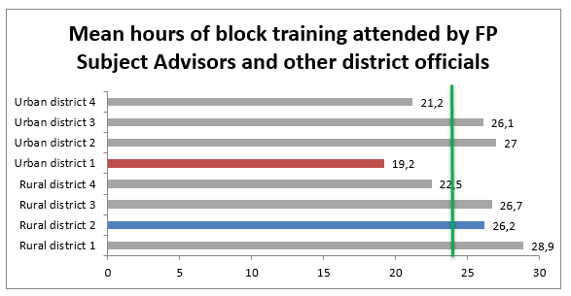
SA/district level findings – block training attendance
Notes:
The block training targeted 70 Subject Advisors
70 Subject Advisors and other district officials attended at least one day of block training
NOTE: we are not able to distinguish between FP Subject Advisors and other district officials due to the format of the attendance registers and what data they collected.
Turnover of Subject Advisors (new subject advisors joining) = 12.8% in 7 months.
The evaluation focused on rural district 2 and urban district 1. Of these 2 districts, attendance was better in rural district 2.

Slide 9
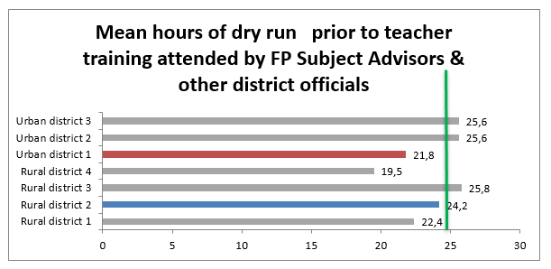
SA/district level findings – dry run attendance
Notes:
79 Subject Advisors and other district officials attended the block training and/or participated in the dry runs

Slide 10
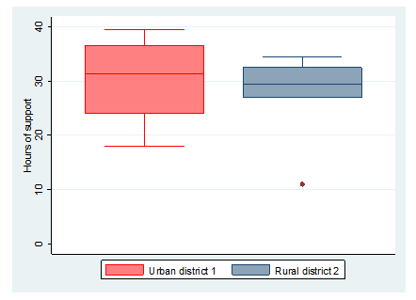
SA/district level findings – average hours of support
Notes:
Box plot showing ave. hours of support provided by SDU in the 2 case study districts
Median = 31.2 hours and 29.5 hours (for UD1 and RD2, respectively)
Greater range of average support in UD1, if exclude the outlier minimum in RD2
The most common forms of support provided to Urban District 1 were “co-facilitate a cluster” followed by “conduct a workshop or dry run”.
The most common forms of support provided to Rural District 2 were “conduct a workshop or dry run”, followed by “facilitate a cluster workshop” and “co-facilitate a cluster workshop”.

Slide 11
SA/district level findings – SA training
5 days of training of 70 SAs, November 2016
By the end of the course, all planned content and objectives were covered.
Initial resistance from the FP Subject Advisors appeared to drop off, particularly when the Activity Guides were first displayed.
Practical, interactive training; good balance between theoretical and practical

Slide 12
SA/district level findings – dry runs (1)
Support by SDU: seven 2 to 3-hour dry runs (in each district), plus one 3.5 day block dry run
All in first half of 2017 (for Phase 1)
Positive points:
Acted as support group
Knowledgeable, calm, well-prepared facilitators
Relaxed pace (at district dry runs)
Easy atmosphere
Opportunity for discussion; plenty of open-ended questions
Very practical – many group discussions and activities
Positive and engaged FP subject advisors

Slide 13
SA/district level findings – dry runs (2)
Points of concern
Materials not always ready on time, and with some errors
Quieter FP subject advisors not always drawn in
Crowded venue for block dry run
Rushed facilitation (at block dry run)
No true ‘dry run’

Slide 14
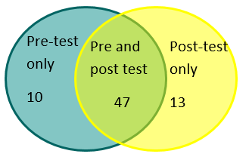
SA/district level findings – test participants & demographics
Pre-test
Notes:
Pre-test: 57/67 Subject Advisors who attended day 1 of the block training wrote the test, provided names and gave consent for their results to be used.
Post-test: 60/64 Subject Advisors present when the post-test was written wrote the test, provided names and gave consent for their results to be used.
47 Subject Advisors wrote both the pre and the post test, provided names and gave consent for their results to be used.
All participants were female, the majority (50.9%) were coloured and aged 46-55 (54.7%).
The participants home languages were Afrikaans (47.2%), English (34%) and isiXhosa (18.9%)
Almost all the Subject Advisors (94.3%) had specialised in FP teaching during their training and 20.8% indicated that they were Grade R specialists
35.8% of Subject Advisors had passed mathematics at a level higher than Grade 12. For 37.8%, the highest level at which they had passed mathematics was lower than Grade 12

Slide 15
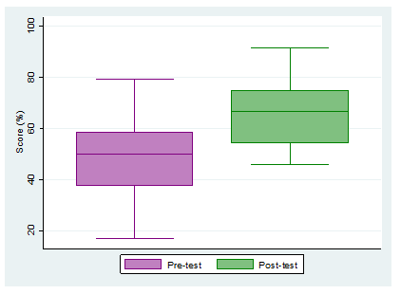
SA/district level findings – test results
Pre-Test Results
Mean score of 48.6%.
Scores ranged from 20% to 80%
Post-Test Results
Mean score of 66.1%.
Scores ranged from 46% to 92%
Increase of 17.5pp pre to post test = significant at 95% confidence level
Large effect (1.44 sd).

Slide 16
Project level findings – stakeholder interviews (1)
An ambitious and complex project, conceptualised, developed and implemented at scale within tight timeframes. That this was possible indicates a successful collaboration. However, there were some internal tensions.
Role players fully committed and largely reported to have fulfilled their roles and responsibilities.
Project Steering Committee
+ effective in highlighting issues, holding role players accountable, facilitating communication and reporting
- established late, limited effectiveness outside of quarterly meetings
Notes:
A number of districts trained fewer teachers in Phase 1 and were, at the time of the endline interviews, being faced with having more teachers to train in Phase 2 than could be trained by their FP Subject Advisors.
Change to the project model/implementation in Phase 2
Cluster notes revised,
Block training shorted to 4 days,
Condensed/concentrated cluster workshops for “top” schools/teachers,
Lead teachers to support Subject Advisors to implement,
On-boarding workshop for principals/HoDs,
Sustainability
Capacitation of new SA’s? Shadowing & peer training
Reflection workshops and establishment of PLCs, missed sessions “caught up” at cluster meetings
Monitoring of implementation? By SA’s and at school level
Uneven capacity of SA’s
Procurement of new materials?
Proposal to provide refresher training at CTLI on a rotational basis

Slide 17
Project level findings – stakeholder interviews (2)
Communication
+ District WhatsApp groups
- some challenges regarding SDU communication with districts & feedback from SDU to WCED regarding support provided
Varied district roll-out models.
Some changes made to the project model between phase 1 & phase 2
Various steps taken to support sustainability
Notes:
A number of districts trained fewer teachers in Phase 1 and were, at the time of the endline interviews, being faced with having more teachers to train in Phase 2 than could be trained by their FP Subject Advisors.
Change to the project model/implementation in Phase 2
Cluster notes revised,
Block training shorted to 4 days,
Condensed/concentrated cluster workshops for “top” schools/teachers,
Lead teachers to support Subject Advisors to implement,
On-boarding workshop for principals/HoDs,
Sustainability
Capacitation of new SA’s? Shadowing & peer training
Reflection workshops and establishment of PLCs, missed sessions “caught up” at cluster meetings
Monitoring of implementation? By SA’s and at school level
Uneven capacity of SA’s
Procurement of new materials?
Proposal to provide refresher training at CTLI on a rotational basis

Slide 18
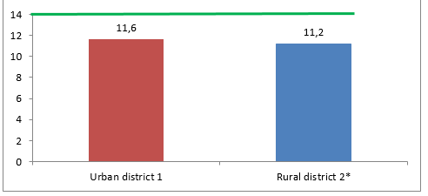
Teacher level findings – cluster workshop attendance
Mean hours of attendance of Grade R teacher/practitioners:

Slide 19
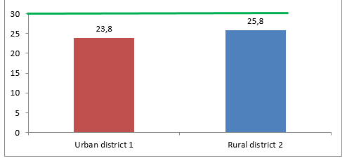
Teacher level findings – block training attendance
Mean hours of attendance of Grade R teacher/practitioners:

Slide 20
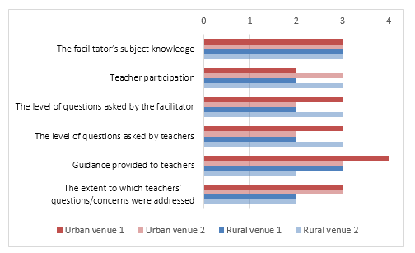
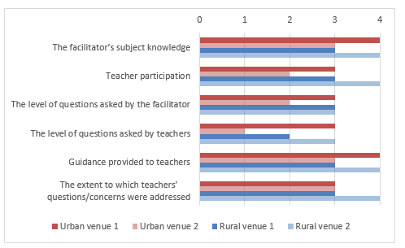
Teacher level findings – cluster workshops
Notes:
There were seven 2-hour CTs and one 5-day block training – all district-based and run by the SAs
This slide shows the observer’s facilitator ratings from CT1&2, and CT 5

Slide 21
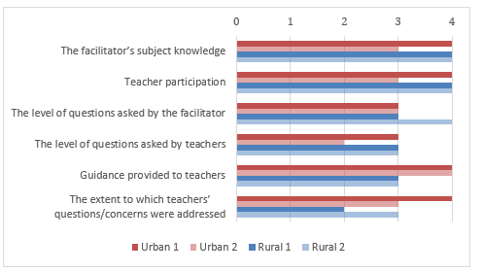
Teacher level findings – cluster block training
Notes:
This shows the observer’s ratings of the facilitators.

Slide 22
Teacher level findings – cluster block training
Summary
The training started unevenly but improved considerably to be of a good to very good standard.
The biggest concerns were:
infrequent open-ended and/or higher-order questions being posed by the facilitators, and
the absence of questioning by the participants.

Slide 23
Grade R teacher/practitioner level – test participants
Pre-test
Pre-test only 53
Pre- and post-test 157
Post-test only 30
Notes:
Results should only be considered at the group level.
All 210 teacher/practitioner participants who were present at the start of the cluster 1 and 2 workshops participated in the pre-test. The test was written on different dates in the two districts where the evaluation is being conducted.
The post-test was written on 7 July 2017 the last day of the block training week. 187 participated in the post-test.
Results for the pre- and post-test were matched for 157 participants.
Small sample; results should only be considered at the group level (not disaggregated beyond district level).
The number writing the pre-test is higher than the number writing the post-test as in the urban district where the evaluation is being conducted a number of teacher/practitioners selected to participate in phase 2 attended the first workshop and wrote the pre-test, but where then requested to attend in phase 2 as planned.
According to the control sheets submitted by the Test Administrators, all participants who were at the block training at the time that the test was written wrote the test. The reason for this discrepancy is not known.

Slide 24
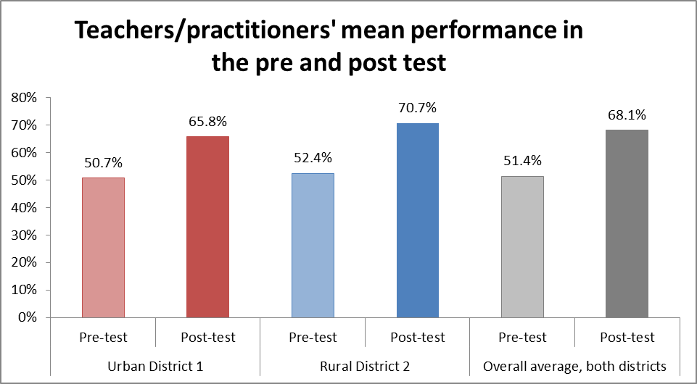
Grade R teacher/practitioner level – test results
Post Test results
Mean score of 68.1%,
Scores ranged from 28% to 96%.
Increase of 16.7pp pre-post test
Significant, large effect (1.37 sd).
Pre Test results
Mean score of 51.4%,
Scores ranged from 16% to 88%.
Notes:
NB note that the SA and teacher tests were different: The teacher test included 11 exactly matched items from the subject advisor test. A further 10 items were significantly shortened to be more direct. Furthermore, the items in the teacher test were presented in a different sequence, and two items were replaced.
The increase of 16.7 percentage points from the pre-test to the post-test mean is significant at the 95% level of confidence (Paired samples T-test, p =< 0.001) and indicates that the participants fared significantly better on the post-test than on the pre-test.
The effect size for the teacher group was large at 1.37 sd.
These are positive findings.
However, there are wide variations in performance within the group.

Slide 25
Case Studies – Planning & teaching (1)
Case study schools were very diverse, all were benefitting from the project. The project is relevant for diverse contexts
Principals/HoDs had attended on-boarding workshops were more aware about the R-Maths at endline. Successful on-boarding.
Teacher confidence had increased in some areas, but some teachers had decreased in confidence in other areas (lesson planning).
Lesson planning was varied and had deteriorated in a number of instances. Over-reliance on the Activity Guides.
Notes:
The schools which were visited for the case studies were varied; they included schools with English, Afrikaans or isiXhosa as the LoLT and a dual medium Afrikaans and isiXhosa school; schools in quintiles 1, 2, 4 and 5; schools in both rural and urban areas; and schools in Urban District 1 and Rural District 2 serving a range of poor to middle class communities.
The recommended lesson structure was generally loosely followed. Free play was often excluded (in schools 1, 2, 4, 5 and 6 at baseline and schools 2, 3, 4 and 5 at endline) due to learners not finishing their group activities and lack of time. In a number of schools (schools 4 and 5 at baseline and schools 3, 4 and 5 at endline), the teacher/practitioner did not work with a focus group during the small group activities. The value of working with a focus group is that teachers can assess learners’ level of understanding, consolidate and build on prior learning and work with learners to deepen their understanding of new concepts. This was not happening consistently, and the practice appears to have declined in frequency from baseline to endline.
Additionally, in some instances (more so at baseline than endline), teacher/practitioners did not clearly explain or model the group activities for the learners, and lessons ended abruptly without a conclusion.

Slide 26
Case Studies – Planning & teaching (2)
Lessons starting late and/or running over time was a fairly common issue.
Lessons observed were all relevant in terms of Mathematics content concepts and skills. They were largely aligned with CAPS and the R-Maths Activity Guides.
The recommended lesson structure was generally loosely followed. Free choice activities were often excluded and in a number of schools the teacher/practitioner did not work with a focus group during the small group activities.
There was effective use of questioning to engage learners, but limited questions were asked by learners, questioning controlled by the teachers
Notes:
The schools which were visited for the case studies were varied; they included schools with English, Afrikaans or isiXhosa as the LoLT and a dual medium Afrikaans and isiXhosa school; schools in quintiles 1, 2, 4 and 5; schools in both rural and urban areas; and schools in Urban District 1 and Rural District 2 serving a range of poor to middle class communities.
The recommended lesson structure was generally loosely followed. Free play was often excluded (in schools 1, 2, 4, 5 and 6 at baseline and schools 2, 3, 4 and 5 at endline) due to learners not finishing their group activities and lack of time. In a number of schools (schools 4 and 5 at baseline and schools 3, 4 and 5 at endline), the teacher/practitioner did not work with a focus group during the small group activities. The value of working with a focus group is that teachers can assess learners’ level of understanding, consolidate and build on prior learning and work with learners to deepen their understanding of new concepts. This was not happening consistently, and the practice appears to have declined in frequency from baseline to endline.
Additionally, in some instances (more so at baseline than endline), teacher/practitioners did not clearly explain or model the group activities for the learners, and lessons ended abruptly without a conclusion.

Slide 27
Case studies - Application of R-Maths principles
Notes:
Fieldworkers rated the extent to which these principles were evident in the lessons which they observed using a five-point scale. The baseline and endline ratings per teacher/practitioner are displayed.
The highest ratings were given for inclusivity and activity, followed by practice, whilst the lowest were given for level.
Some teacher/practitioners were better than others at teaching in a context which is meaningful for learners.
There were very small differences overall in the average baseline and endline ratings of the R-Maths principles; guidance, interaction and context remained the same; inclusivity and, interaction declined slightly; and practice and level improved slightly.
1 = not at all, 2 = to a limited extent, 3=somewhat, 4=most of the time, 5=extensively.
The findings must be interpreted keeping in mind that the ratings were derived from the observation of just one Mathematics lesson at baseline and another at endline.

Slide 28
Case studies – support for Grade R teaching
Support within the school from peers, “mentors” and HoDs varied.
In small schools, limited staff/full teaching loads makes lesson observation challenging.
Reported in school-based support, including lesson observation, since baseline.
Increase in FP Subject Advisor confidence to support Grade R teaching, with a new focus/emphasis on Grade R.
Support from FP Subject Advisors is highly appreciated in schools ,and some HoDs/teacher reported that this had increased/improved from baseline to endline.
At endline, stakeholders at all schools reported that support from the FP Subject Advisors included Grade R Mathematics lesson observations.
Notes:
At baseline, limited support was provided to the Grade R teacher/practitioners by the FP HoDs. Two schools (schools 1 and 2) did not have HoDs and two schools (schools 2 and 4) had other arrangements in place to support Grade R teacher/practitioners. In only one school (school 6) was it reported that the HoD observed Grade R lessons; however, while the HoD at the school confirmed this, the teacher/practitioner disputed it. A number of the HoDs who were interviewed at baseline had limited knowledge of the R-Maths Project and felt ill-equipped to support implementation.
The scenario had improved somewhat at endline. Three HoDs and one Acting HoD reported attending the onboarding workshop organised by the WCED to inform principals and HoDs about the R-Maths and ELIT interventions. Increased support was reported to be provided by HoDs to Grade R teacher/practitioners as follows:
School 1 – the “mentor” still provided weekly support and now conducted lesson observations;
School 2 – the acting FP HoD who previously did not provide any support now provided weekly support and conducted monthly lesson observation;
School 3 – views were mixed as to the support provided by the HoD and the support did not include lesson observations;
School 4 – the HoD was reported to provide weekly support (an improvement on the minimal support reported at baseline) and conduct lesson observations termly;
School 5 – the HoD provided weekly support (as reported previously) but now also conducted lessons observations (monthly-termly);
School 6 − the HoD provided monthly-termly support (more than was previously reported) and has promised to conduct classroom observations and check implementation now that she has been trained.
The FP Subject Advisors who were interviewed had varied numbers of schools and teacher/practitioners to support. The case study districts where the evaluation was conducted had one ECD specialist FP Subject Advisor per district who supported all ECD sites (including Grade R classes) in the district and FP Subject Advisors who supported Grades R-3 in a smaller number of schools in a specific geographic area. Providing support to Grade R was a relatively new mandate for FP Subject Advisors.
At baseline, one school reported that the FP Subject Advisors focused on the FP and did not support Grade R. School stakeholders by-and-large valued the (limited) support they received from FP Subject Advisors highly. Only one of the schools (school 6) reported that FP Subject Advisors conducted classroom visits to support Grade R.
Due to the small size of the school and provision not being made for the post.
From School 2, which did not have an FP HoD post.
WCED provincial officials reported that this was deliberate, since they believed that the teacher/practitioners needed to become comfortable with R-Maths before being monitored by HoDs, and therefore the onboarding took place in August 2017.

Slide 29
Learner level findings - Methodology
Instrument: Marko-D test (of early Mathematics) – with 47 items, focussing on Number, at 5 different conceptual levels
Initial simple random sample of learners in 2 districts: 168 in each of the intervention and comparison groups, in each district (total of 672 individual learners)
Baseline in Feb/Mar 2017; endline in Oct/Nov 2017
Test conducted orally in schools, one child at a time, administered by trained test administrators
Children completed the test in their LoLT
Due to attrition etc., there was a total of 622 matched tests
Notes:
Attrition from base- to endline due to illness, leaving schools, etc.
Matched tests mean tests where both base- and endline were written by the same child.

Slide 30
Learner level findings: Urban District 1
Most learners (≈70-80%) were assessed in English.
A small minority of these were ELLs (i.e. were assessed in English but were not English HL)
Almost all remaining learners were learning Mathematics in their HL of isiXhosa.
Independent sample t-tests showed that the net shifts were not significantly different.
Notes:
Intervention group improved 19.6pp
Comparison group improved 20.3pp
Comparison group improved more than intervention group, but this difference was too small to be significant.

Slide 31
Learner level findings: Rural District 2
Most learners (≈75% in the intervention group, and 100% in the comparison group) were assessed in Afrikaans.
All remaining learners were learning Mathematics in their HL of isiXhosa.
Independent sample t-tests showed that the net shifts of the intervention learners were significantly higher than those of the comparison group, with a small effect size.
Notes:
Intervention group improved 16.4pp
Comparison group improved 13.3pp
Intervention group improved more than comparison group.
This difference was big enough to be significant, with a small effect (d=0.21)

Slide 32
Learner level findings: General linear model of whole sample – set up
Fixed effects:
Baseline test scores,
District (urban, rural), and
Group (intervention, comparison)
Dependent variables:
Marko-D endline total scores, and
Marko-D endline scores, by level (L1, L2, L3, L4, L5)
Factors included:
Gender (Male; Female),
Quintile (1; 2; 3; 4; 5),
LoLT (E, A, X), and
Age
Notes:
Set up = what is included in the model
The FACTORS are all potential predictors of performance
The baseline scores are introduced as fixed effects to provide a base from which to measure change

Slide 33
General linear model on whole result: findings 1
Greatest (medium) effects on Marko-D performance were:
LoLT (isiXhosa- and Afrikaans-speakers improved best; English-speakers least) – for all levels and total, and
District (urban learners improved more, at L3 to L5, and total)
Weaker (small) effect on Marko-D performance were:
Group (intervention group learners performed better at L2, L3 and L5 and on whole test), and
Age (older learners performed better at L2, L3 and L4)
No significant effects on Marko-D performance for:
Gender
Quintile

Slide 34
General linear model on whole result: findings 2
Impact of group
Group (intervention group learners performed better at L2, L3 and L5 and on whole test)
Notes:
Children whose teachers had received the intervention, performed approximately 4.5 to 5.5 percentage points better than children whose teachers were not in the intervention on the Levels identified above, and almost 3 percentage points better on the total test.

Slide 35
General linear model on whole result: conclusions
Biggest effects were on Levels 2 and 3 of the Marko-D.
Grade R children in the intervention group were performing similarly to those Grade R learners in the comparison schools who were six months older (when assessed at Levels 2 and 3 of Marko-D).
Expecting large differences in improvements in learner scores in a short space of time is unrealistic. Overall, therefore, the fact that the R-Maths intervention had a generally small but positive effect on the Mathematics results of children whose teachers had been exposed to the intervention is encouraging.
Notes:
This refers to 6 months of general child development, and not 6 months of schooling, since all learners in this study were in Grade R

Slide 36
Comparisons with findings from other SA studies
1. ELOM (50-59 and 60-69 month)
Difference between >5 y.o and <5 y.o norms for emergent Maths is only 2.5 percentage points.
2. Reading catch-up research project (Grades 1-3)
The study showed an overall improvement from both control and intervention schools, with intervention schools showing a slightly better performance particularly in specific areas of reading (spelling and grammar)
3. WCED LitNum
Grade 1 Numeracy mean: 4 pp: 27% (2009) to 31% (2012)
4. E-Lit (2016 lit/lang intervention in Grade R across Gr R)
6 months after the intervention training began (Mid-Grade R): 0.41 SD
End of Grade R: 0.24 SD
End of Grade 1: No significant difference.
Notes:
E-lit: could have given Grade R learners a temporary head start but this learning advantage was not sustained. There was no lasting impact beyond Grade R

Slide 37
Meta-analyses of impact of interventions
Education interventions in Gr1-3 have average effect size of 0.18 SD (Hill, Bloom, Black and Lipsey, 2008)
Sub-Saharan African meta analysis (Conn, 2017):
Overall effect size for all education intervention types : 0.18 SD
Education interventions focusing on pedagogy: 0.92 SD

Slide 38
Answering the evaluation questions
What the Project entails was summarised in the programme theory document.
Implementation occurred in a (relatively)-affluent, (mostly) urban province which is performing (relatively) well in Mathematics, and where Grade R teachers are likely to be (relatively) well qualified and districts are functional.
The project was largely implemented as planned.
Training and support
FP Subject Advisors: 30 hrs block training, dry-runs; additional support as requested .
Teachers/practitioners: 14 hrs CT; 30 hrs block training; WhatsApp support groups; reflection workshop & PLC .
Notes:
Nature & quality of the training & support provided to FP Subject Advisors:
The quality of this training was high, with engaging and knowledgeable SDU facilitators covering the material in a variety of largely interactive ways including the frequent use of concrete apparatus.
The FP Subject Advisors also benefitted from dry runs prior to the CTs and block training of the teacher/practitioners and other support provided (such as co-facilitation of CTs, facilitation of CTs in unusual situations and provision of verbal and written explanations). In the two case study districts, an average of 30.6 hours (Urban District 1) and 27.3 hours (Rural District 2) of additional support (i.e. above and beyond the 30 hours of block training and 29 hours of dry run prior to the block training of teacher/practitioners) was provided by the SDU, mostly in the form of CT dry runs.
The support provided at the dry runs observed by the evaluators was of a high quality, with a good relationship evident between the facilitator and the FP Subject Advisors. However, WCED provincial officials raised concerns about the uneven quality of support provided across districts; it may be that in some cases the facilitators were not as competent as those that the evaluation team observed.
Nature & quality of the training & support provided to Grade R teacher/practitioners:
Observation by the evaluation team in different venues in the case study districts showed that the venues used for training and the training itself were of variable quality, although in no case was the venue or training below a satisfactory standard. The same FP Subject Advisors facilitators were observed a number of times, and observers generally reported improvements in the quality of the training provided as the project progressed.
The teacher/practitioners received support in between CTs via WhatsApp groups. These were reported to be a good forum for staying in touch with peers, clarifying issues which were unclear, requesting assistance and sharing good practices. The provision of in-classroom support by FP Subject Advisors was limited, due to the number of schools/teacher/practitioners which FP Subject Advisors have to support and their workloads (R-Maths is just one of their responsibilities).
Teachers/practitioners received limited support to implement at school level, and this was an issue, particularly for teacher/practitioners who were the only Grade R teacher/practitioner at a school. From the case study findings, there is evidence that support provided to Grade R teacher/practitioners by FP Subject Advisors and FP HoDs increased/improved slightly during the course of 2017.

Slide 39
Answering the evaluation questions
5. Teacher/practitioners are utilising the materials to plan & execute their lessons. Lessons observed were relevant irt maths content, concepts & skills & aligned with CAPS & R-Maths. The recommended lesson structure was being loosely followed. The R-Maths principles were being implemented to varying degrees.
6. Implementation challenges:
Districts: Limited human resources, FP Subject Advisors heavy workload, FP Subject Advisors uneven knowledge of supporting Grade R
Schools: Limited support for teacher/practitioners to implement content and methodologies imparted via the Project.
7. An ambitious and complex project was conceptualised, developed and implemented on a provincial-scale within tight timeframes & implemented largely as planned, indicating a successful partnership model. However, there were tensions between some of the project partners.
Notes:
However, in a number of instances, personalised lesson planning appears to have reduced since the baseline, as teacher/practitioners were treating the Term Activity Guide as a lesson plan (rather than as a framework to build on).
Free choice activities were often omitted due to learners not finishing their group activities and lack of time, and a number of teacher/practitioners were not working with a focus group during the small group activities.

Slide 40
Answering the evaluation questions
8. Grade R teacher/practitioners received resources and training (but limited support to implement). Mixed findings wrt confidence. Increased motivation to teach Mathematics. Knowledge of Grade R Mathematics and the effective teaching thereof increased. Some evidence that lesson planning deteriorated. Mixed findings on whether application of the R-Maths principles had improved.
9. Positive, significant & large impact on:
FP Subject Advisors’ knowledge of Grade R Pedagogical Knowledge, Subject Matter Knowledge (SMK) and Pedagogical Content Knowledge (PCK).
Grade R teacher/practitioners’ knowledge (PK), (SMK) & (PCK)
Notes:
(specifically, level – from a low base − and practice), but the application of level, guidance and interaction remained limited

Slide 41
Answering the evaluation questions
10. Positive, significant but small impact on the learners’ mathematical knowledge and understanding.
That the entire cohort of FP Subject Advisors received extensive training and support, & their knowledge of supporting Grade R Mathematics teaching bodes well for sustainability within the WCED.
Risks include: turnover of FP Subject Advisors, their heavy support load and competing priorities. Additional support (e.g. Lead Teachers, HoDs) will be required to embed the project.

Slide 42
Process theory
10. Has the project achieved its intended outcomes?
Impact theory
Development of resources
Resource use for training & in the classroom
Short-term
Enhanced knowledge & skills to support Grade R teacher/ practitioners (district officials)
Capacitation of district officials
Medium-term
Training of Grade R teacher/ practitioners
Support to Grade R teacher/ practitioners
Enhanced knowledge & skills to teach Grade R Maths (Grade R teacher/practitioners)
Effective teaching of Maths
Improved learner performance in Maths (readiness for Grade 1)
Long-term (impact)
Notes:
Simplified ToC – in order to answer the question Has the project met its intended outcomes outlined in the theory of change and logic model?
Green = achieved
Orange = partially achieved
The R-Maths Project had 24 intended outcomes linked to the three objectives.
Four out of six outcomes linked to the first objective (development of resources and training materials) were fully achieved:
Materials developed for a comprehensive R-Maths Programme, with a distinct focus on development of Mathematical concepts;
Participating FP Subject Advisors benefit from training by a formal, credible institution;
Schools and Grade R teacher/practitioners are resourced to implement effective Grade R Mathematics teaching; and
Grade R Mathematics lessons are energetic and fun.
This outcome was mostly achieved:
Materials for the R-Maths Programme are accessible in all LoLTs used in the Western Cape.
The materials were accessible in all LoLTs, but FP Subject Advisors delivering the training had the resources only in English in the early CTs. If they were facilitating in a language other than English, they should have had the resources in the other language from the start.
This outcome was partially achieved:
FP Subject Advisors and teacher/practitioners benefit from registration through SACE as part of their CPTD.
The training has been registered with SACE, but only those who are SACE-registered can benefit. Full registration status is awarded to those practitioners with a Grade R teaching diploma and fully-qualified teachers. Those with NQF level 4 but registered for NQF level 5 and those with NQF level 5 receive provisional SACE registration. Thus, there are quite a large number of Grade R teacher/practitioners who do not qualify to benefit from this.
Of the nine outcomes linked to the second objective (capacitation of FP Subject Advisors), three were fully achieved:
FP Subject Advisors have enhanced confidence to support Grade R Mathematics teaching.
FP Subject Advisors demonstrate improved content and pedagogic knowledge of early Mathematics.
FP Subject Advisors act as knowledgeable Grade R Mathematics resource persons for the WCED.
Two were mostly achieved:
FP Subject Advisors are prepared and capacitated to deliver CTs effectively.
FP Subject Advisors are prepared and capacitated to provide quality training to teacher/practitioners in Grade R Mathematics.
The above outcomes were mostly achieved in that the quality of the CTs and block training delivered by FP Subject Advisors was mostly good, although it did vary.
The evaluation did not gather sufficient evidence (due to the limited evaluation scope) to provide an assessment of the following outcomes related to the second objective:
FP Subject Advisors are able to identify and articulate good Mathematics practice in Grade R.
FP Subject Advisors can identify aspects of Grade R Mathematics teaching that are working as well as areas for improvement and plan how to sustain and maintain impact going forward.
FP Subject Advisors are able to identify and differentiate support needs of schools and teachers/ practitioners.
FP Subject Advisors provide mentoring to Grade R teacher/practitioners beyond the lifespan of the project.
Of the 10 outcomes linked to the third objective (capacitation of Grade R teachers), four were fully achieved:
Grade R teacher/practitioners have improved content and pedagogic knowledge of early Mathematics.
Grade R teacher/practitioners can interpret and implement the Mathematics curriculum.
Availability of R-Maths materials in the classroom.
Use of R-Maths materials in lessons.
The following outcome was mostly achieved (as evidenced in the lessons observed as part of the case studies):
Grade R Mathematics lessons are energetic and fun.
The following outcome was partially achieved:
Grade R teacher/practitioners have improved confidence and motivation to teach Mathematics.
The case studies found that teacher/practitioners’ motivation to teach Mathematics had generally increased; but in some instances, their confidence in certain areas of Grade R Mathematics teaching had declined from baseline to endline.
The achievement of the following teacher/practitioner level outcomes was mixed, based on the results of the case study lesson observations:
Grade R teacher/practitioners develop and implement appropriate lesson plans.
Grade R teacher/practitioners apply interactive teaching methods and include the seven principles (context; activity; level; interaction; guidance; inclusivity; and practice) in the classroom.
Grade R teacher/practitioners can identify aspects of their Grade R Mathematics teaching that are working as well as areas for improvement and plan how to improve their teaching practice going forward.
The seven principles are effectively applied, resulting in: good classroom management; focused lessons; learners are actively engaged; integration of play-based learning; mediation between abstract and concrete.
The lessons which were observed were energetic and fun to varying degrees. More detail can be found in the case study reports.
Teacher/practitioners were asked to rate their confidence in their abilities in various areas of Grade R Maths. The reason for the decline in some areas is not known but it could be a case of “not knowing what you don’t know” at baseline and “knowing what you don’t know” at endline.

Slide 43
Recommendations for future roll-out (1)
Complete an expert review of the R-Maths materials.
Translate the R-Maths materials into the eight official South African languages currently without R-Maths materials – possible adaptation to fit more closely the local contexts.
Establish a Project Steering Committee (PSC) during the planning stage of the project.
Appoint a high-level official from the local PED as the Chair of the PSC.
Follow up all decisions made at PSC meetings, and hold members accountable.
Involve an expert external support team in the roll-out.
Replicate the dry runs, BUT allow for genuine ‘dry runs’
Notes:
These are the EVALUATORS’ RECOMMENDATIONS
to ensure their alignment with CAPS and their inclusion of the most appropriate strategies to teach Mathematics to five- to six-year-old South Africa children.
Nothing
PSC right from the outset – and more frequent meetings early on
Nothing
Processes for resolving conflicts or overcoming implementation blockages should be agreed – including grievance procedures
Similar to SDU, with uniformly high standards of facilitators. Not a ‘one size fits all’ but tailored training determined by the context and baseline test findings
Nothing

Slide 44
Recommendations for future roll-out (2)
Replicate the use of the FP Subject Advisors in training the Grade R teacher/practitioners.
Develop the capacity of the FP Subject Advisors before they train teachers/practitioners.
Use only Grade R Maths-competent FP Subject Advisors as trainers.
Replicate the FP Subject Advisors’ training and Grade R teacher/practitioners’ training in quantity & style, BUT over a longer period and at smaller scale.
Start with the block training.
Enable Lead Teachers to play a large role – with appropriate additional training.
Notes:
This has many advantages – including increasing contact between SAs and teachers, and increased SA knowledge and confidence.
A cascade model will not work if the people at any level are of poor quality
If they do not obtain high enough marks on the post-training test, they should need to attend further training, and be re-tested, before beginning to train themselves
Duration of perhaps one year, and scale of two or three districts at a time
Nothing

Slide 45
Recommendations for future roll-out (3)
Assess the Grade R teacher/practitioners more comprehensively, post-training.
Link the training to some formal, accredited qualification.
Support the Grade R teacher/practitioners after training in implementing what they have learnt.
Provide the same training to all new staff: FP Subject Advisors and Grade R teacher/practitioners.
Ensure the R-Maths programme is the sole PED intervention in the FP during the period of implementation.
Develop to plan to clarify how the learnings from the project are to be consolidated and embedded at all levels.
Evaluate future roll-outs, to add to the evidence base.
Notes:
Retrain and re-test those who do not pass
This will add to the Gr R teacher motivation
This involves classroom observations – by SAs or FP HoDs (problem of heavy workloads and/or lack of knowledge), or LTs. This could include multiple PLCs – perhaps involving micro-lessons. Also, geographically-based FP Subject Advisor/teacher/practitioner WhatsApp support groups.
This will need, therefore, repeated roll-outs of R-Maths
And for as long as possible afterwards, to ensure embeddedness
Without a plan, it is likely to dissipate over time due to other competing demands
The evidence of impact on learner performance is currently somewhat questionable, and so needs further testing.

Slide 46
Recommendations for subsequent grp discussions
Policy Same training to all new FP Subject Advisors and Grade R teacher/practitioners Make R-Maths the only intervention being implemented Link the training to some formal, accredited qualification | Context Adapt the content focus for each province
Resources Expert review Translation to ‘missing’ languages Adaptation for context Use of WhatsApp groups | Model All other recommendations!
Notes:
These include only reccs included in our report.

Slide 47
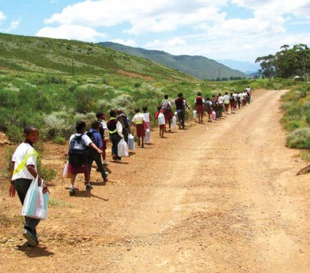
THANK YOU

