Slide 1
Grade R Maths project External Evaluation Methodology

Slide 2
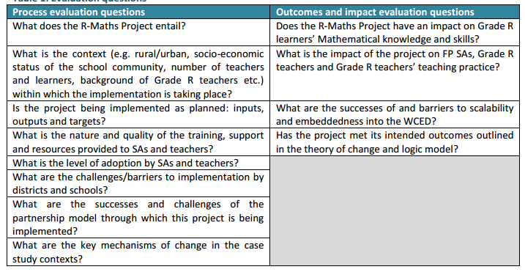
Research questions
Notes:
8 process evaluation questions
4 outcomes/impact evaluation questions

Slide 3
Data collection methods and sources
Activities | Level
 | Project/ province | District | School | Teacher | Learner
Key stakeholder interviews | x
Subject Advisor test | x
Teacher test |  | x |  | x
Training observation | x | x
Training dry-run observation | x | x
Cluster workshop observation |  | x
Cluster workshop dry-run observation |  | x
Monitoring fidelity, tracking “dosage” | x | x |  | x
Case studies |  |  | x | x
Learner test |  | x |  |  | x

Slide 4
Testing
Assessments
2016 2017
Subject Advisor Assessment
Pre test
Post test
All
Teacher Assessment
Pre test
Post test
2 districts, assess all
Learner Assessment
Pre test
Post test
2 districts, select random sample
Inter-vention
Control
Inter-vention
Control
Notes:
SA assessment – the entire population (who agree to participate) will be assessed
Teacher assessment – in two districts the entire population (who agree to participate) will be assessed
Learner assessment – learners attending schools receiving the intervention in 2017 represent the intervention group, learners attending schools receiving the intervention in 2018 represent the control group. In two districts a simple random sample of 168 learners will be drawn i.e. 336 learners in total and sampled at two points in 2017. We have assumed an effect size on 0.3 (medium effect), power of 95% and significance level of 95%. Risk that if the effect is smaller than 0.3 we may not see an effect. The findings will be generalisable in the two districts where the study is conducted. The sample size is not sufficient for sub-group analysis (by gender, race, language, school quintile etc).

Slide 5
Limitations to evaluation design
Short SA and teacher test instruments (30 minutes each)
Limited choice for district options
Use of simple random sampling of learners
Smallish sample size of learners tested
Baseline data was collected in schools after commencement of the project
Occasionally, use of different fieldworkers for case study & training observations, and learner testing
Case studies: no counter-factual observations
Notes:
Tests: Limited what could be tested. Also low reliability
District options: due to distances and methods by which the districts decided on how to divide their teachers/schools into Phase 1 and 2. Two of the most functional districts were ultimately chosen
SRS: increases chances of a school being represented by a small number of learners. Cluster sampling would have been better, but was not possible due to budget constraints
Sample size: limited the power of the impact calculations, and ability to disaggregate at lower level. BUT did have sufficient to test and measure overall effects

